Slide 1
OIC-SHPA 2014-2023 & Vaccines Need Assessment in OIC Member Countries
Prof. Savas Alpay
Director General
STATISTICAL, ECONOMIC AND SOCIAL RESEARCH AND TRAINING CENTRE FOR ISLAMIC COUNTRIES
ORGANIZATION OF ISLAMIC COOPERATION

Slide 2
OIC Strategic Health Programme of Action 2014-2023

Slide 3
OIC-SHPA 2014-2023
SESRIC lead the preparation of OIC-SHPA and its Implementation Plan in collaboration with OIC member countries and Institutions and International Health organizations;
OIC-SHPA is a framework of cooperation among OIC member countries, relevant OIC institutions and international organizations in the domain of health
OIC-SHPA aims to strengthen health care delivery system and improve health situation in OIC member countries especially by facilitating and promoting intra-OIC transfer of knowledge and expertise

Slide 4
SIX Thematic Areas of Cooperation
Health System Strengthening
Maternal, New-born and Child Health and Nutrition
Medicine, Vaccine and Medical Technologies
Emergency Health Response and Interventions
Information, Education, Research and Advocacy
Disease Prevention and Control
1
2
3
4
5
6

Slide 5
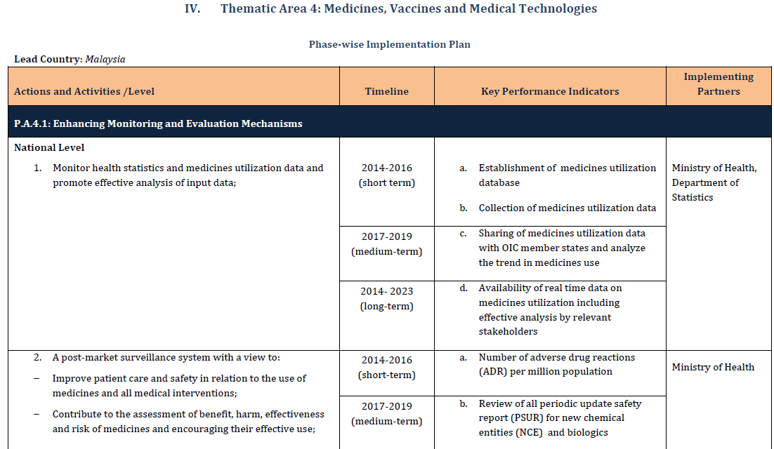
Implementation Plan of the OIC-SHPA
Implementation Plan is based on OIC-SHPA findings and describes actions/activities under each TA with:
i- Timeline for their implementation (short, medium and long term)
ii- Key Performance Indicators (KPIs) to monitor the implementation
iii- Implementing partners (both national and international institutions)

Slide 6
Thematic area 4: Medicine, Vaccine and Medical Technologies
focuses at medicines and vaccines manufacturing, monitoring and evaluation mechanisms and promotion of research and development (R&D) and innovation.
proposes four programmes of action with several actions and activities:
PA–1 Enhancing Monitoring and Evaluation Mechanisms
PA–2 Supporting Local Production of Medicine and Vaccines
PA–3 Promoting Research and Development (R&D) in Health-related fields
PA–4 Increasing the Availability of Essential Medicines, Vaccines and Technologies
1
2
3
4
5
6

Slide 7
Thematic area 4: Medicine, Vaccine and Medical Technologies
Some selected activities from Implementation Plan:
Facilitating training among member countries through sharing of knowledge and expertise for the development and strengthening of pharmacovigilance system
Improving investment climate by simplifying the requirements for doing business in pharmaceutical and other medical products industry
Establishing an intersectoral intra-OIC committee of experts on local production
Providing material and technical assistance to develop national guidelines related to distribution of vaccines
Facilitating development of OIC regional pooled procurement mechanism which will enable local production to meet regional needs and allow for the mutual cooperation in increasing the availability of essential medicines and vaccines
1
2
3
4
5
6

Slide 8
Vaccines Need Assessment

Slide 9
Vaccines and Immunization
Childhood immunization is one of the most efficient and effective methods of preventing diseases like Measles, Meningitis, Diphtheria, Tetanus, Pertussis (whooping cough), Yellow fever, Polio and Hepatitis B.
Immunization is an essential component for reducing under-five mortality.
Immunization coverage estimates are used to monitor coverage of immunization services and to guide disease eradication and elimination efforts.
It is a good indicator of health system performance.

Slide 10
WHO Recommended Immunization Schedule
Age of Contact | Vaccine
Birth | BCG, OPV-0, Hep B
6 weeks | OPV1, Penta1 (DTP, Hep B*, Hib)
10 weeks | OPV2, Penta2 (DTP, Hep B*, Hib)
14 weeks | OPV3, penta3 (DTP, Hep B*, Hib)
9 months | Measles, Hep B*, YF
12-15 months | Measles 2nd dose and Rubella

Slide 11
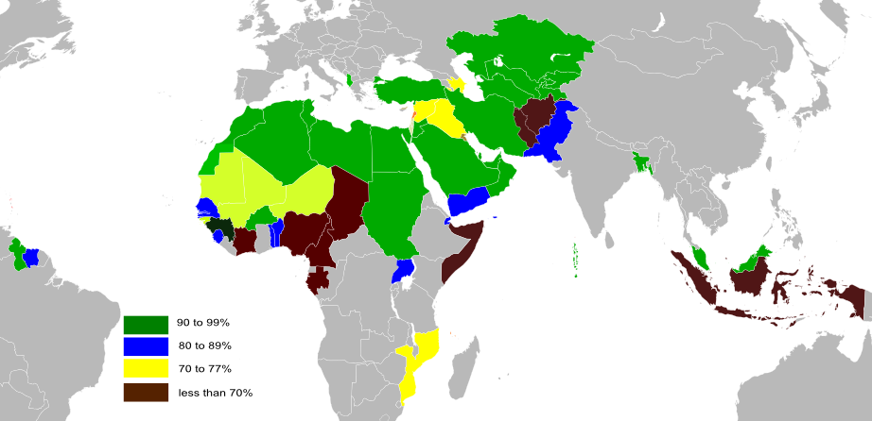
DTP3 Immunization Coverage: 3rd dose of Diphtheria-Tetanus-Pertussis (2012)
OIC Countries | 83
Other Developing | 85
Developed | 95
World | 83
OIC Regions
SSA | 73
SA | 87
MENA | 91
ECA | 94
EAP | 84
LAC | 92

Slide 12
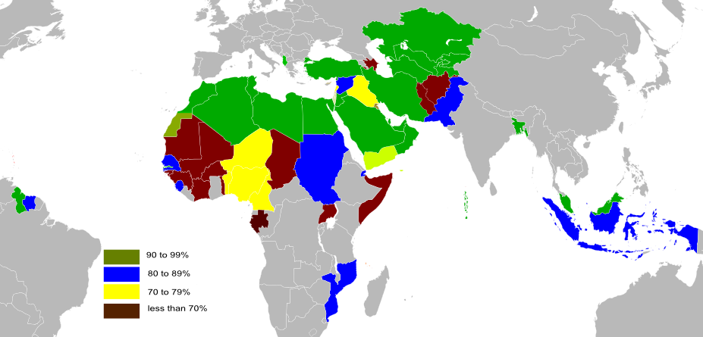
MCV: Measles Immunization Coverage (2012)
OIC Countries | 81
Other Developing | 85
Developed | 92
World | 84
OIC Regions
SSA | 53
SA | 80
MENA | 89
ECA | 91
EAP | 78
LAC | 92

Slide 13
Polio Immunization Coverage (2012)
OIC Countries | 75
Other Developing | 83
Developed | 97
World | 84
OIC Regions
SSA | 75
SA | 83
MENA | 93
ECA | 95
EAP | 74
LAC | 95

Slide 14
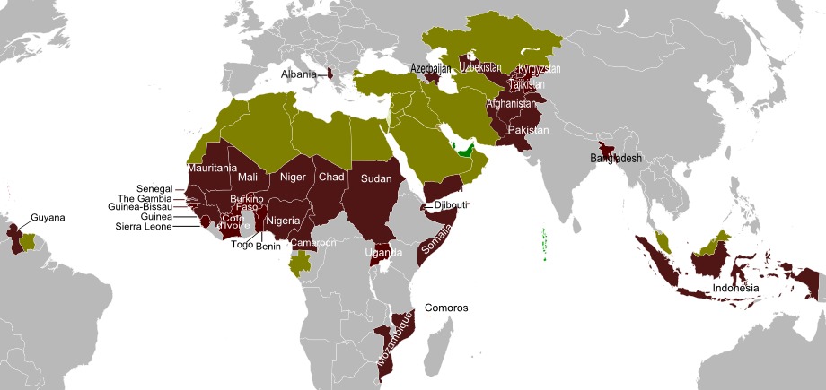
Vaccines Need Assessment: Country Coverage
Data acquired from GAVI Alliance.. covers only 31 MCs (colored dark red) with following regional distribution:
SSA | 19
SA | 3
MENA | 2
ECA | 5
EAP | 1
LAC | 1

Slide 15
Penta Vaccine ‘five-in-one’..for Diphtheria, Tetanus, Whooping cough, Hepatitis B and Haemophilus influenzae type b (Hib)

Slide 16
DTP3 (for Diphtheria-Tetanus-Pertussis)

Slide 17
OPV3 (for Polio)

Slide 18
MCV (for Measles)

Slide 19
Tetanus

Slide 20
BCG (for Tuberculosis)

Slide 21
Current Stance of Vaccine Supply
OIC countries display heterogeneous structure in terms of being able to uptake new vaccines.
Low income countries obtain vaccines mostly through GAVI Alliance.
Middle income countries have been experiencing financial and operational difficulties with the introduction of new vaccines. They have the following obstacles:
Lack of sufficient funds
Prevailing high prices of vaccines
High income countries such as GCC have been successful in the uptake of new vaccines.

Slide 22
Current Stance of Vaccine Distribution
The purchase of vaccines is complex and requires a specialized knowledge and a precise approach.
Due to the specificities of the vaccines, quality, safety and efficacy should be the first considerations to be taking into account.
Cold chain conditions should be respected during shipment and cold room capacity should be available at the time of the receipt of the vaccines.
There are many companies producing vaccines but only a few meet internationally-recognized standards of safety and efficacy.

Slide 23
Exports of Vaccines for Human Use
OIC countries are still accounting for less than 1% of the total world vaccine exports.
OIC exports of vaccine recorded only 122.7 million USD in 2012.

Slide 24
Imports of Vaccines for Human Use
OIC countries accounted for 8% in total world vaccine imports in 2012.
OIC imports of vaccine recorded over 1.5 billionUSD in 2012 which is almost 13 times higher than their exports.

Slide 25
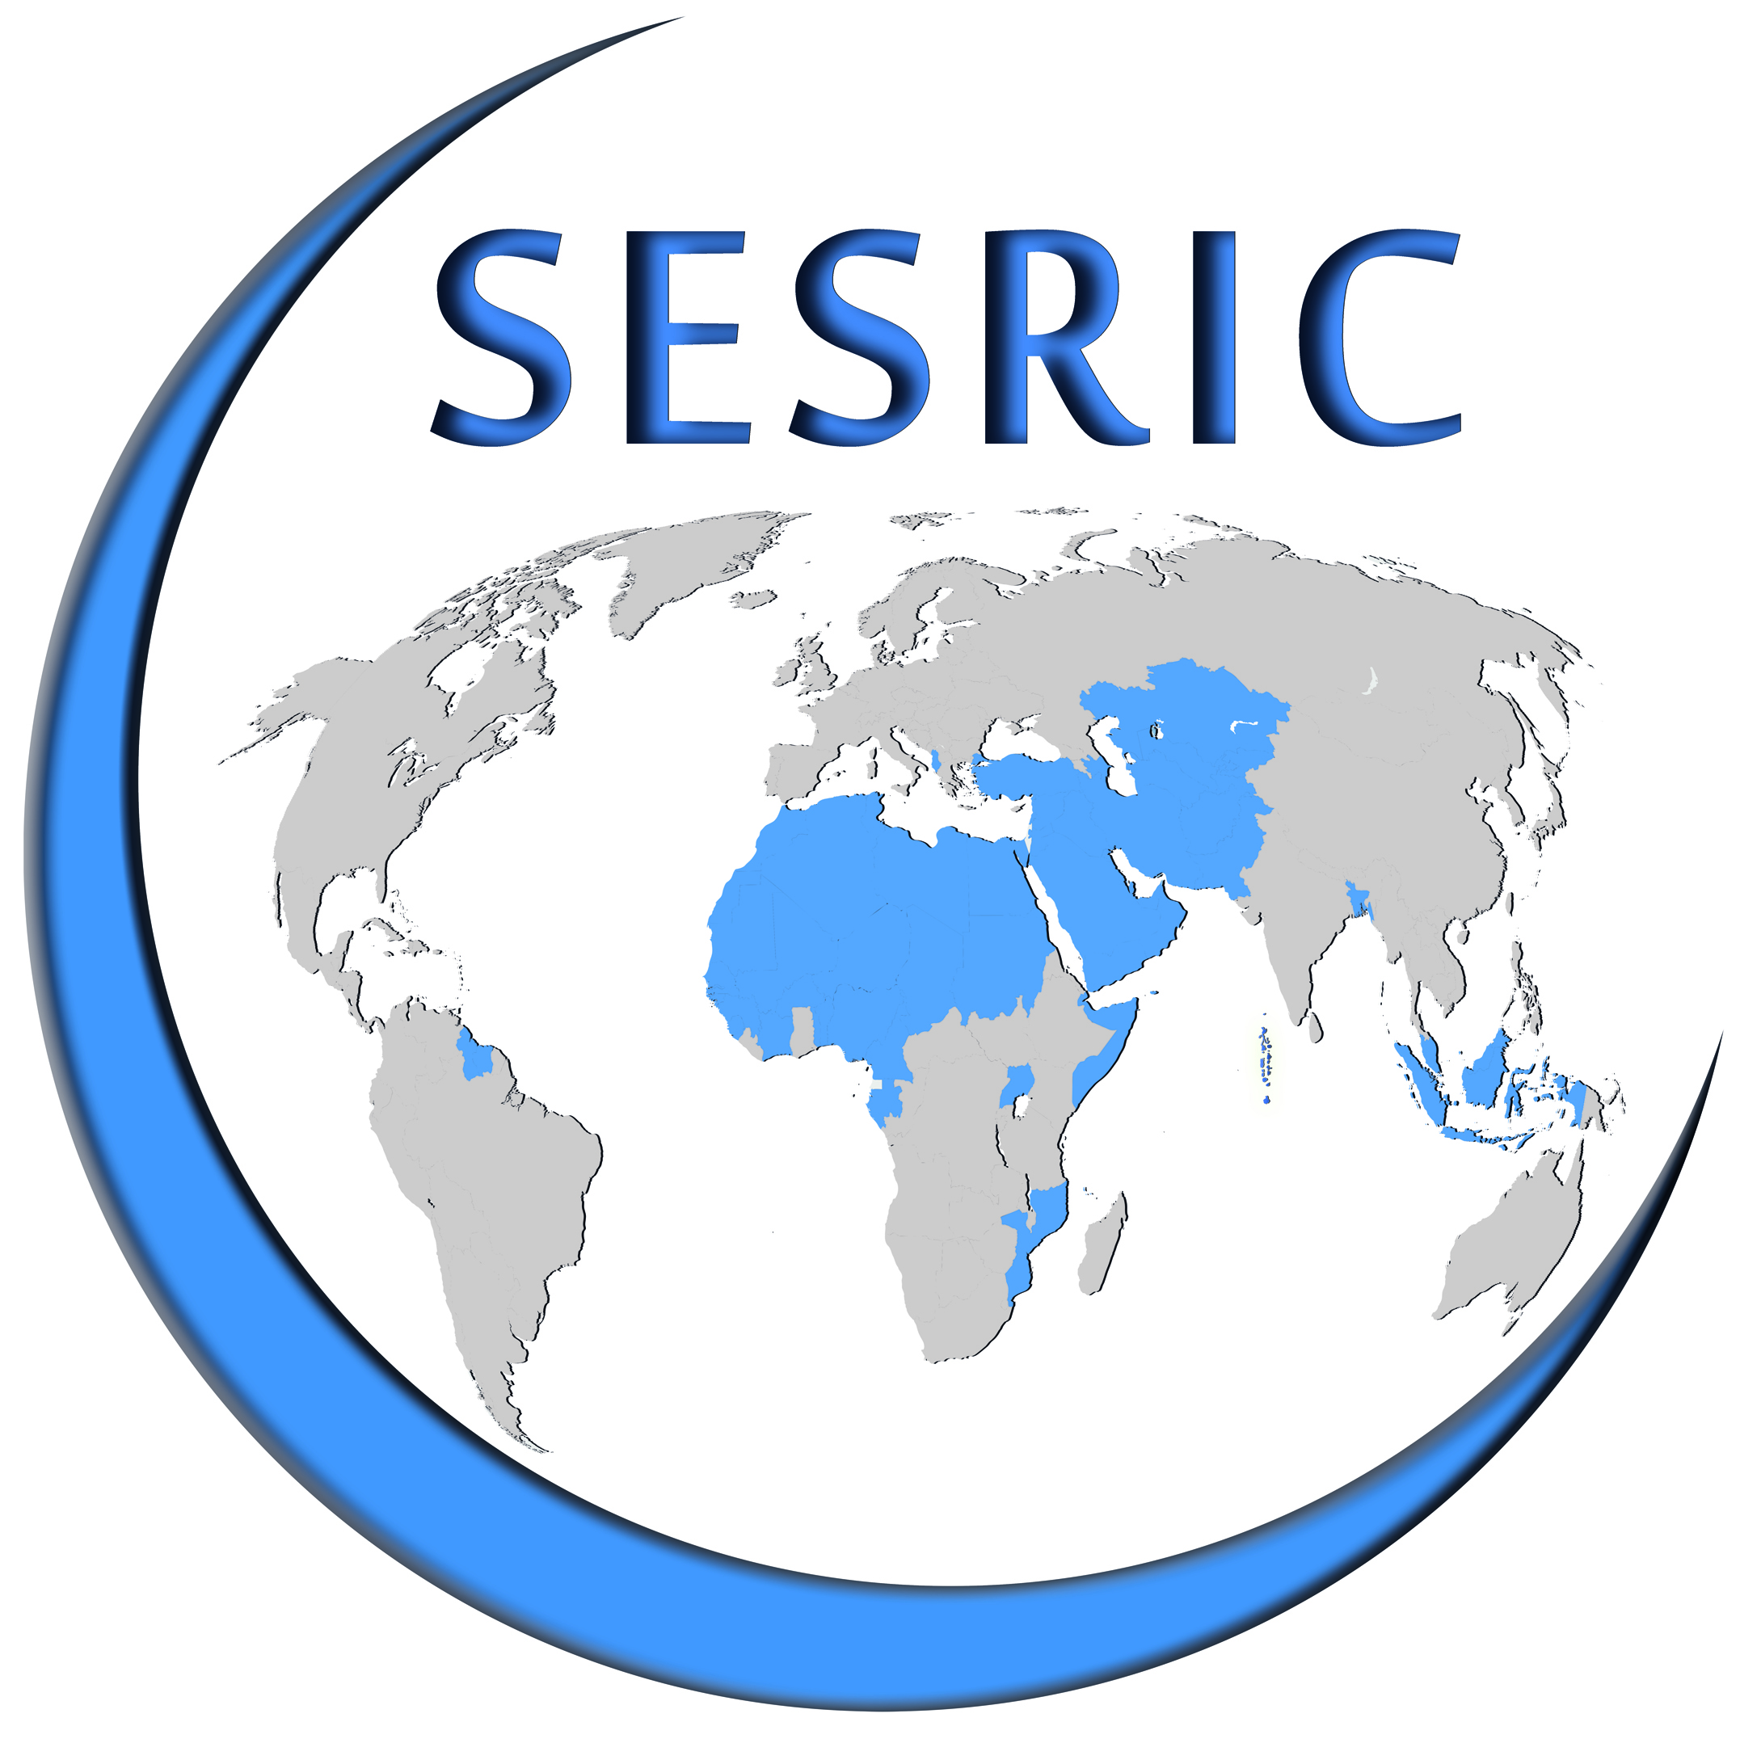
Thank you for your attention!
http://www.sesric.org

