Slide 1
Institut Pasteur de Tunis
www.pasteur.tn
120 years dedicated to Public Health

Slide 2
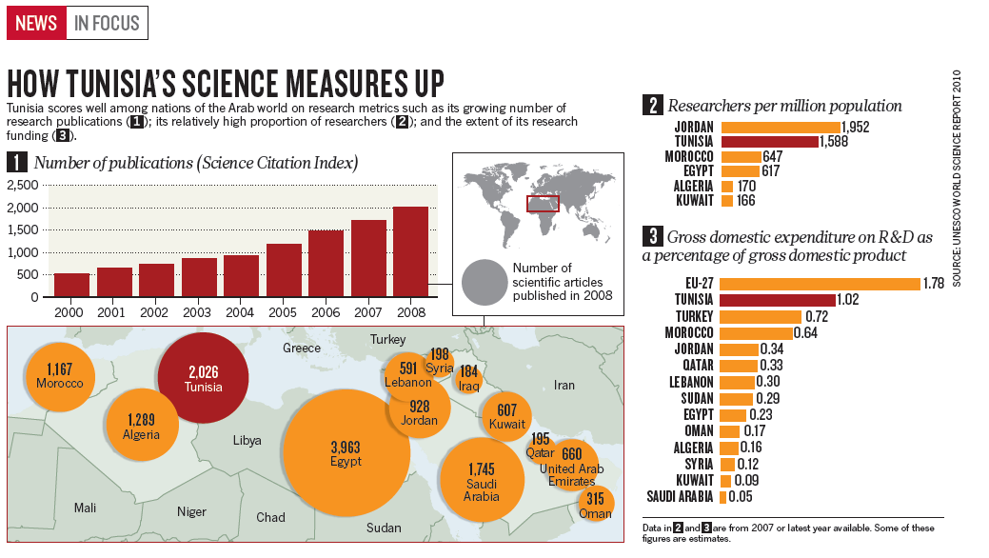
Tunisian scientists rejoice at freedom
(2 7 Ja n ua ry 2 0 1 1 | VO L 4 6 9 | n aT u r E | 4 5 3)
As revolution reshapes the country, researchers lay plans for a system that will foster free thinking and innovation.

Slide 3
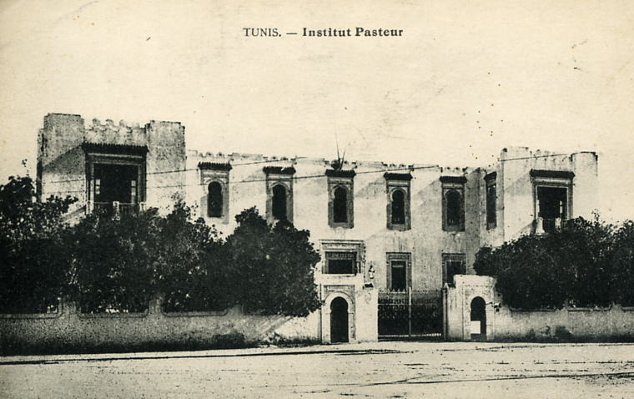
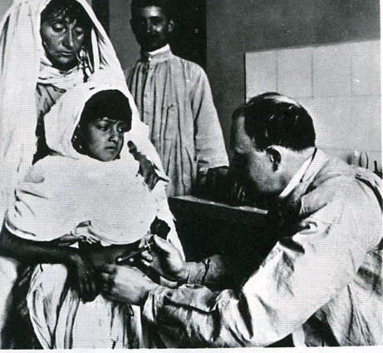
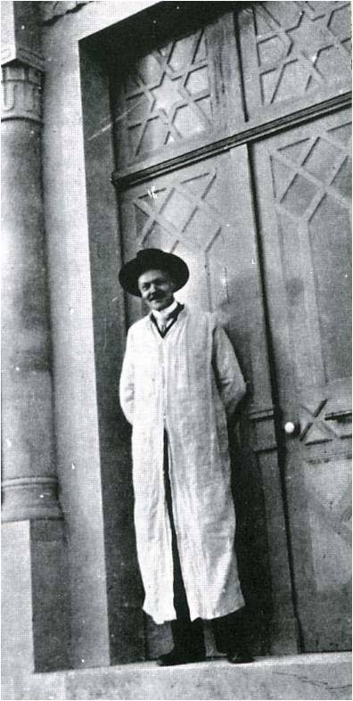
Founded in 1893
Institut Pasteur de Tunis in 1905
Since the beginning, major discoveries were made (Transmission cycles of Thyphus, toxoplasmosis, visceral leishmaniasis, concept of unapparent infections)
Devoted to people’s health
Charles Nicolle, director of Institut Pasteur de Tunis from 1903 to 1936
Nobel price in Medicine, 1928

Slide 4
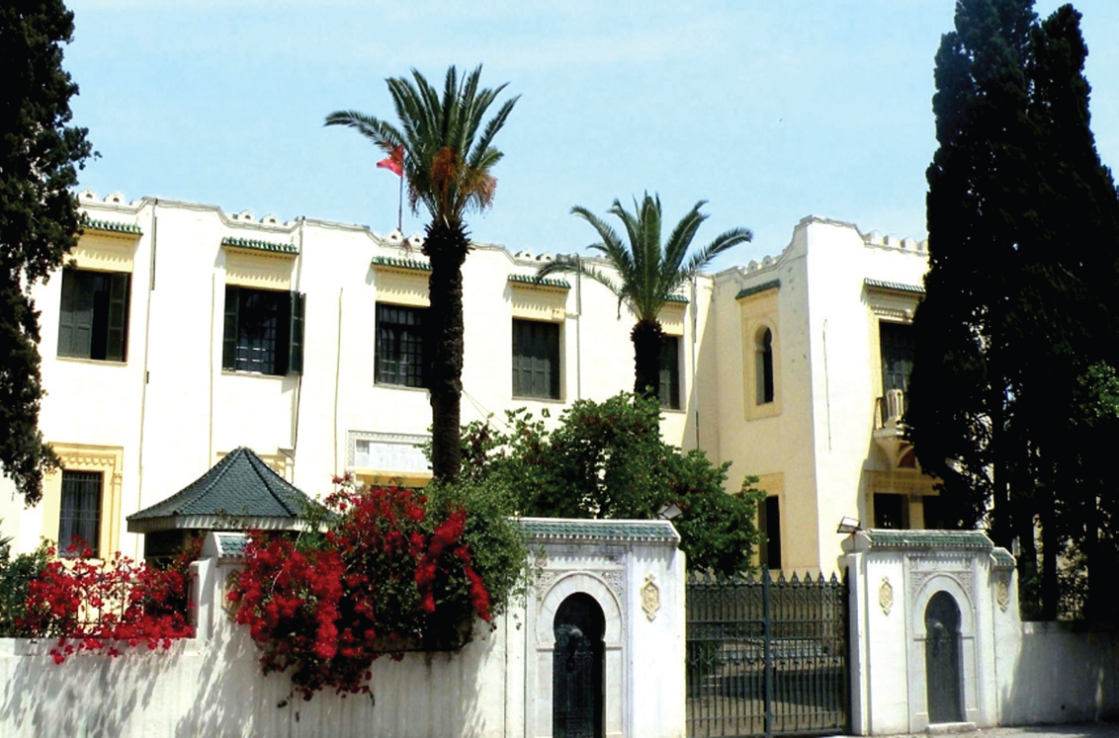

Slide 5
Institut Pasteur de Tunis
Missions:
Biomedical Analysis and Public Health Activities
Production of therapeutic sera and vaccines
Research & development
Training
Councils:
Administrative Council (16 members)
Scientific Council : DG + 8 elected members from IPT
Enlarged Scientific Council: SC+4 Tunisians from outside IPT+4 internationals
Committees
Medical Ethics Committee
Communication, valorization and technology transfer
Committee on Health and Safety
Training committee

Slide 6
Human ressourses
Institut Pasteur de Tunis

Slide 7
Biomedical Analysis and
Public Health activities
18 laboratories + 2 services (35 biologists): Cover the quasi-totality of clinical biology tests. IPT is recognized for the expertise of some of the laboratories in the specialized medical biology.
IPT hosts several national (rabies, poliomyelitis, measles, bacteria, other) or international reference centers (for the Eastern Mediterranean Region/WHO: for poliomyelitis and measles, HPV)
IPT is a center for vaccination (for the travelers) and a center for rabies treatment and vaccination (free).
Notes:
7

Slide 8
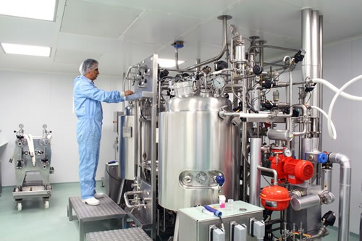
Bioproduction activities
BCG vaccine
Therapeutic sera:
- Anti-scorpions : Androctonus australis, Buthus occitanus
- Anti-vipera: Cerastes cerastes, Vipera lebetina
- Anti-rabies
Notes:
8

Slide 9
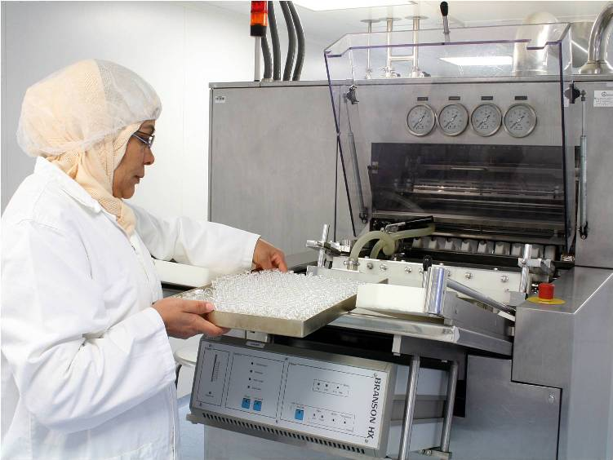
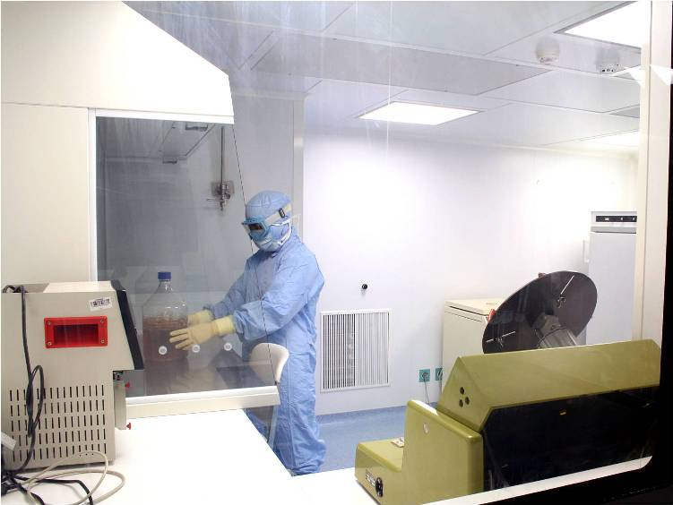
Notes:
9

Slide 10
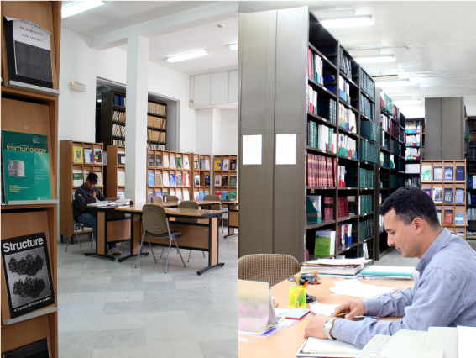
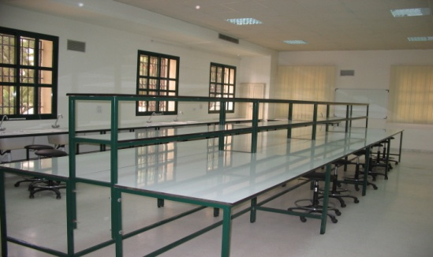
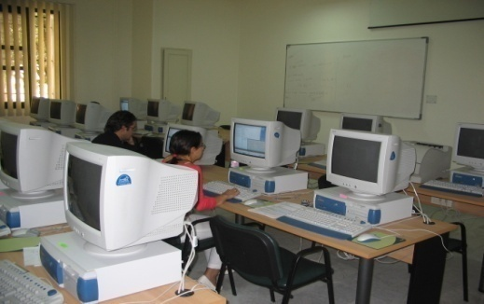
Training activities
IPT linked to University Tunis El Manar
Activities with the various universities and at international level
Organization of theoretical and practical courses in the various domains of the biology, new technologies
Direction of PhDs of various national and international universities (sciences, medicine, others)
Notes:
10

Slide 11
Research & development
Field of activities
Infectious diseases +++ (national health priorities) Leishmaniasis, hydatidosis, tuberculosis, viral hepatitis, rabies, papillomavirus, enteroviruses, avian virus, other veterinary microbial diseases, etc.
Scorpion and snake biochemistry/immunology
Congenital immune deficiencies/immune disorders
Genetic susceptibility to metabolic and infectious diseases, cancer
R&D biotechnology and bioprocesses (rabies, measles, Hepatitis C, veterinary vaccines)
Bioinformatics and Mathematical modeling
Entomology
Clinical Epidemiology and Control (including clinical trials)
Notes:
11

Slide 12
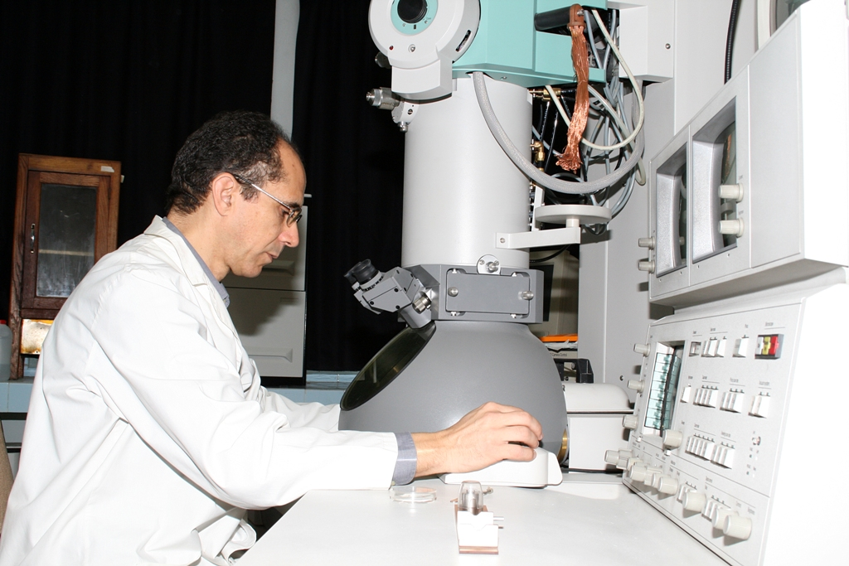
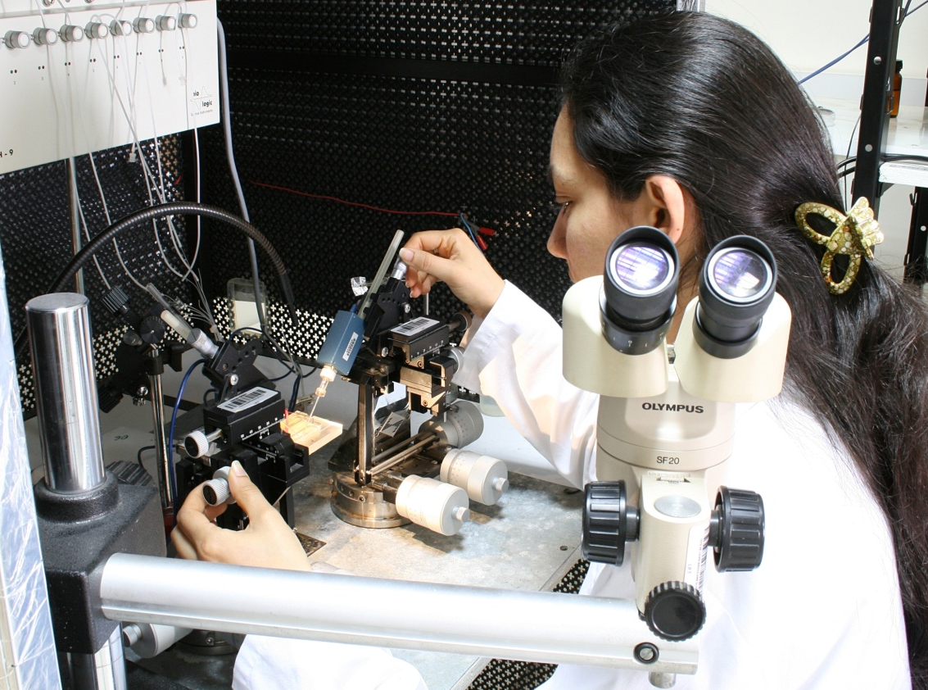
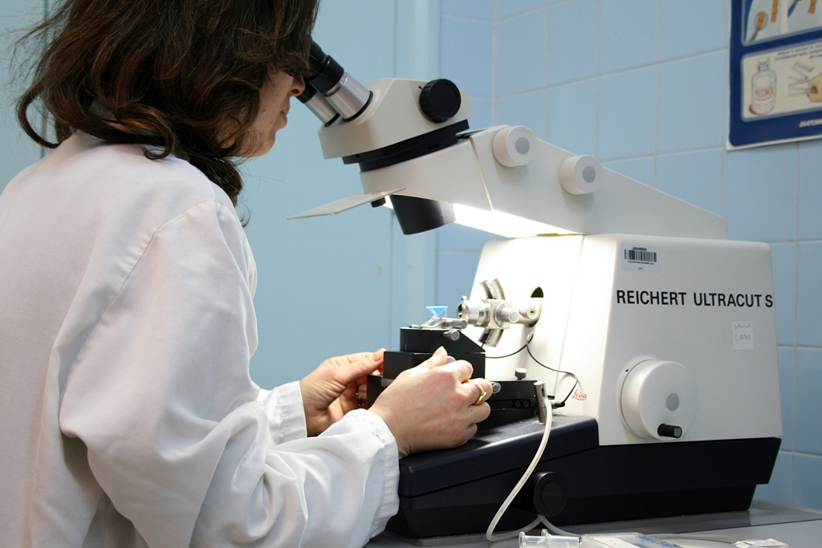

Slide 13
Research & development
Financial support
National support through the eligibility of the groups to be Research Laboratories (9) supported by the Tunisian Ministry of Higher Education and Scientific Research
International financial supports from European Commission-PCRD; World Health Organization/TDR; National Institutes of Health; Walter Reed Army Institute of Research; International Agency of Atomic Energy; The Wellcome Trust; Agence Nationale de Recherche; OTAN; The network of Pasteur Institutes-RIIP; NEPAD; TWAS; notably).
PCI Internal Collaborative Program, 2nd year.
Notes:
13

Slide 14
Funding agencies (alphabetic order) Nature of the grant
ANR (Paris, France) R&D
BIO-RAD (Paris, France) Patent strengthening
European Commission (Brussels, Belgium) R&D
Fondation Mérieux (Lyon, France) Euro-Mediterranean Public Health Information System
Fort Dodge Animal Health Vaccine development and validation
International Atomic Energy Agency
(Vienna, Austria) R&D capacity building and training
Institut Pasteur International Network
(Paris, France) R&D and Public Health Activities (control)
Joint WHO/EMRO-COMSTECH
(Islamabad, Pakistan) R&D
National Institutes of Health (Maryland, USA) R&D, clinical research
North Atlantic Treaty Organization
(Brussel, Belgium) R&D
The New Partnership for Africa’s Development
(Johannesburg, South Africa) R&D
Walter Reed Army Institute Of Research
(Washington, USA) Clinical trials (phase II and phase III)
Welcome Trust (London, UK) R&D, training
WHO/EMRO (Cairo, Egypt) R&D for control
World Health Organization TDR
(Geneva, Switzerland) R&D, capacity building, training

Slide 15
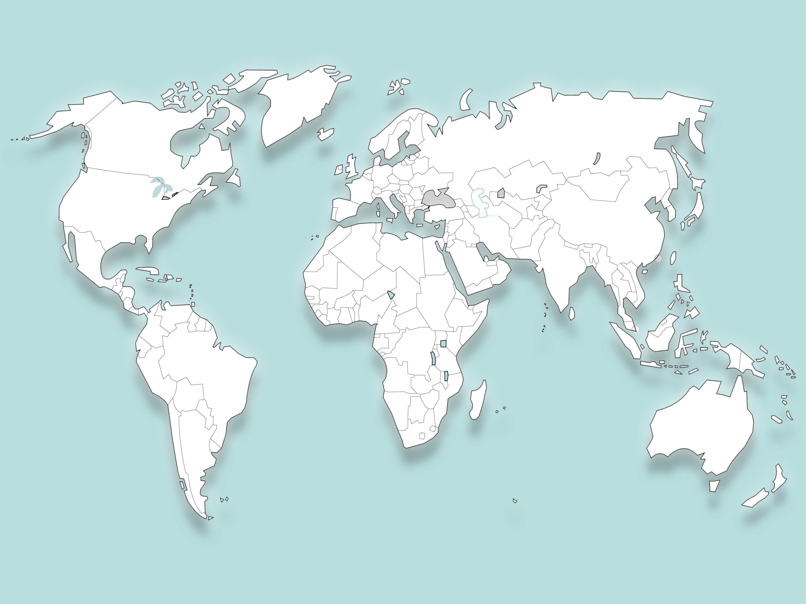
International Partners of Institut Pasteur de Tunis
17 funding agencies
66 ongoing research projects
More than 75 partners institutions in 28 countries
CSE-Juin 2011

Slide 16
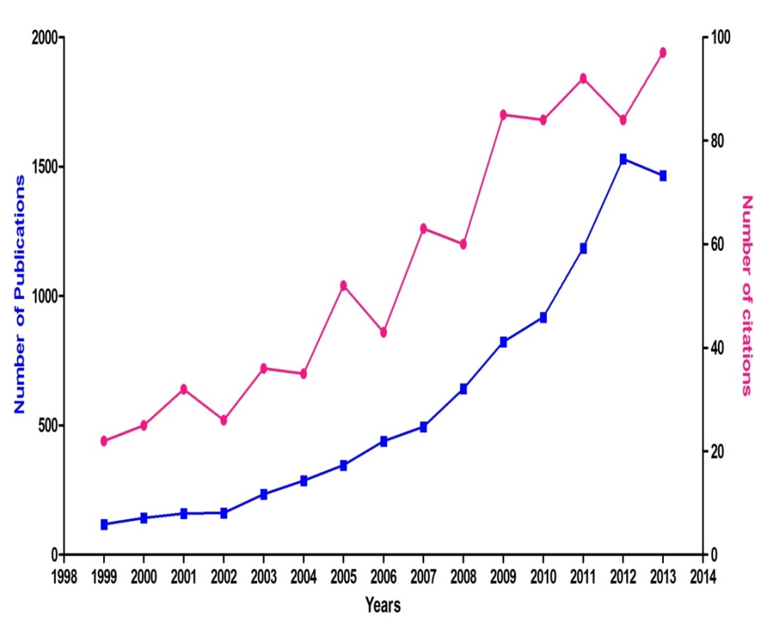
Chimeric polypeptide useful as a medicament comprises a selectin C-type lectin domain joined through a linker to an integrin von Willebrand A domain having a metal ion-dependent adhesion site (FR2909672, 2008-06-13) FATHALLAH MOHAMED DAHMANI; JARBOUI MOHAMED ALI; DELLAGI MOHAMED KOUSSAY
METHOD FOR PREPARING RECOMBINANT MYCOBACTERIAL POLYPEPTIDES IN YEAST AND THEIR USE IN DIAGNOSIS OF MYCOBACTERIAL RELATED DISEASES (WO2008010096, 2008-01-24 ). FATHALLAH MOHAMED DAHMANI (TN); BARBOUCHE MOHAMED RIDHA (TN); HO JOHN L (US); BENABDESSELEM CHAOUKI (TN); DELLAGI KOUSSAY (TN); LARGUECHE BEYA (TN)
RECOMBINANT PICHIA PASTORIS STRAINS AND PROCESS FOR THE PRODUCTION OF RECOMBINANT HUMAN INTERFERON ALPHA (WO2007099462, 2007-09-07) FATHALLAH MOHAMED DAHMANI (TN); KALLEL HELA (TN); DELLAGI KOUSSAY (TN); REBHI IMEN (TN); AYED ATEF (TN)
MAUROCALCINE, ANALOGUES THEREOF AND THEIR THERAPEUTICAL USES (DE60126067D, 2007-03-08) KHARRAT RIAD (TN); MABROUK KAMEL (FR); EL-AYEB MOHAMMED (TN); ROCHAT HERVE (FR); SABATIER JEAN-MARC (FR)
GENE ASSOCIATED WITH LEISHMANIA PARASITE VIRULENCE (YU99603, 2006-05-25) BEN ACHOUR YOSSER (TN); CHENIK MEHDI (TN); LOUZIR HECHMI (TN); DELLAGI KOUSSAY (TN)
POLYPEPTIDES OF LEISHMANIA MAJOR AND POLYNUCLEOTIDES ENCODING SAME AND VACCINAL, THERAPEUTICAL AND DIAGNOSTIC APPLICATIONS THEREOF (WO2006108720, 2006-10-19) CHENIK MEHDI (TN); LAKHAL SAMI (TN); LOUZIR HECHMI (TN); DELLAGI KOUSSAY (TN)
COMPOSITION COMPRISING THE N-TERMINAL REGION OF LEISHMANIA HISTONE H2B, USE THEREOF FOR INDUCING AN IMMUNE RESPONSE (WO2006097642, 2006-09-21) CHENIK MEHDI (TN); LOUZIR HECHMI (TN); DELLAGI KOUSSAY (TN)
LEISHMANIA ANTIGENS SUITABLE FOR A DIAGNOSTIC KIT OF LEISHMANIA (WO2006079565, 2006-08-03) DELLAGI KOUSSAY (TN); KAMOUN-ESSGHAIER SAYDA (TN); GUIZANI IKRAM (TN)
USE OF ZKW PEPTIDE FOR PREPARING AN INHIBITOR DRUG AGAINST PLATELET AGGREGATION (WO2005014021, 2005-02-17) MARRAKCHI NAZIHA (TN); MABROUK KAMEL (FR); SABATIER JEAN-MARC (FR); EL AYEB MOHAMED (TN); ROCHAT HERVE (FR)
Amino-butyrate derivatives of venoms (GB2335923, 1999-10-06) SABATIER JEAN-MARC (FR); EL-AYEB MODHAMMED (TN); VAN RIETSCHOTEN JURPHAAS (FR); ROCHAT HERVE (FR)
LEBETIN PEPTIDES AS PLATELET AGGREGATION INHIBITORS (WO9829436, 1998-07-09) ROCHAT HERVE (FR); MABROUK KAMEL (FR); EL-AYEB MOHAMMED (TN)
VACCINE COMPOSITION COMPRISING RECOMBINANT BCG EXPRESSING GP63 FUSION PROTEIN (WO9610081, 1996-04-04) GICQUEL BRIGITTE (FR); ABDELHAK SONIA (FR); DELLAGI KOUSSAY (TN); LOUZIR HECHMI (TN)
Publications, Citations, Patents
(Nov. 2013)

Slide 17
International Partners in IPT publications
(5 years: 2009-1013: 437 publications)
155: Partners Institutions:
55 Nationals (7 universities)
100 internationals: 69 countries

Slide 18
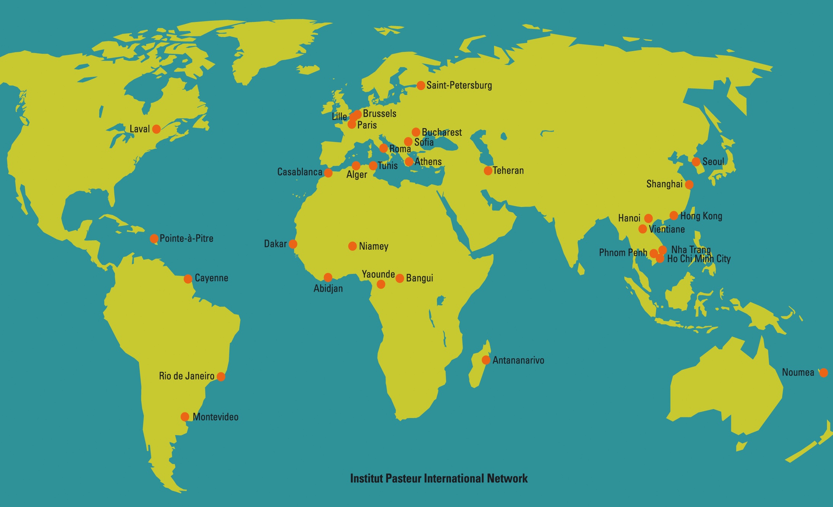
The Institut Pasteur
International Network

Slide 19
Institut Pasteur de Tunis
ANDI Centre of Excellence for Bio-molecules Discovery
African Network for Drugs and Diagnostics Innovation (ANDI), United Nations Economic Commission for Africa (UNECA), Menelik II Avenue, PO Box 3001, Addis Ababa, Ethiopia. Tel: +251 11 544 362; E-mail: info@andi-africa.org

Slide 20
Promote African-led health product innovation to address African’s public health needs through efficient use of local knowledge, research networks and building of capacity

